Slide 1

Customer Shopping Behavior Analysis
Uncovering insights from transactional data to guide strategic business decisions.

Slide 2
Project Overview & Dataset
Project Goal
Dataset Snapshot
Analyze 3,900 purchases to understand spending, segments, preferences, and subscriptions.
3,900 Rows, 18 Columns
Customer Demographics (Age, Gender, Location)
Purchase Details (Item, Category, Amount, Season)
Shopping Behavior (Discounts, Previous Purchases, Reviews)
Missing Data: 37 Review Ratings
Optimize operations, reduce costs, improve forecasting.

Slide 3

Exploratory Data Analysis (Python)
01
Data Loading & Exploration
Imported with pandas, checked structure and summary statistics.
02
Data Cleaning
Handled missing 'Review Rating' by imputing median per category.
03
Standardization & Feature Engineering
Renamed columns to snake_case, created age_group and purchase_frequency_days.
04
Database Integration
Loaded cleaned data into PostgreSQL for SQL analysis.

Slide 4

Key SQL Insights: Revenue & Discounts
High-Spending Discount Users
839 customers used discounts but still spent above average.
Revenue by Gender
Female
75,191
Male
157,890
Male customers generate significantly higher revenue.
Opportunity to analyze discount effectiveness.

Slide 5
Product Performance & Shipping
Top 5 Products by Rating
Shipping Type Comparison
Gloves: 3.86
Sandals: 3.84
Boots: 3.82
Hat: 3.80
Skirt: 3.78
Standard
58.46
Express
60.48
Express shipping users have slightly higher average spend.
These items consistently receive high customer satisfaction.

Slide 6
Subscription & Discount Dynamics
Subscribers vs. Non-Subscribers
Discount-Dependent Products
Hat: 50.00%
Sneakers: 49.66%
Coat: 49.07%
Sweater: 48.17%
Pants: 47.37%
Yes
1053
59.49
62645
No
2847
59.87
170436
Non-subscribers represent larger customer base and revenue.
These products are frequently purchased with discounts.

Slide 7

Customer Segmentation & Loyalty
Returning — 701
New — 83
Loyal — 3116
Understanding customer segments helps tailor marketing strategies.
Loyal
Returning
New
3116 Customers
701 Customers
83 Customers

Slide 8
Top Products by Category & Age Group Revenue
Top 3 Products per Category
Revenue by Age Group
Accessories: Jewelry, Sunglasses, Belt
Clothing: Blouse, Pants, Shirt
Footwear: Sandals, Shoes, Sneakers
Outerwear: Jacket, Coat
Young Adult
62143
Middle-aged
59197
Adult
55978
Identified best-selling items within each product category.
Senior
55763
Young Adults contribute the highest revenue.

Slide 9
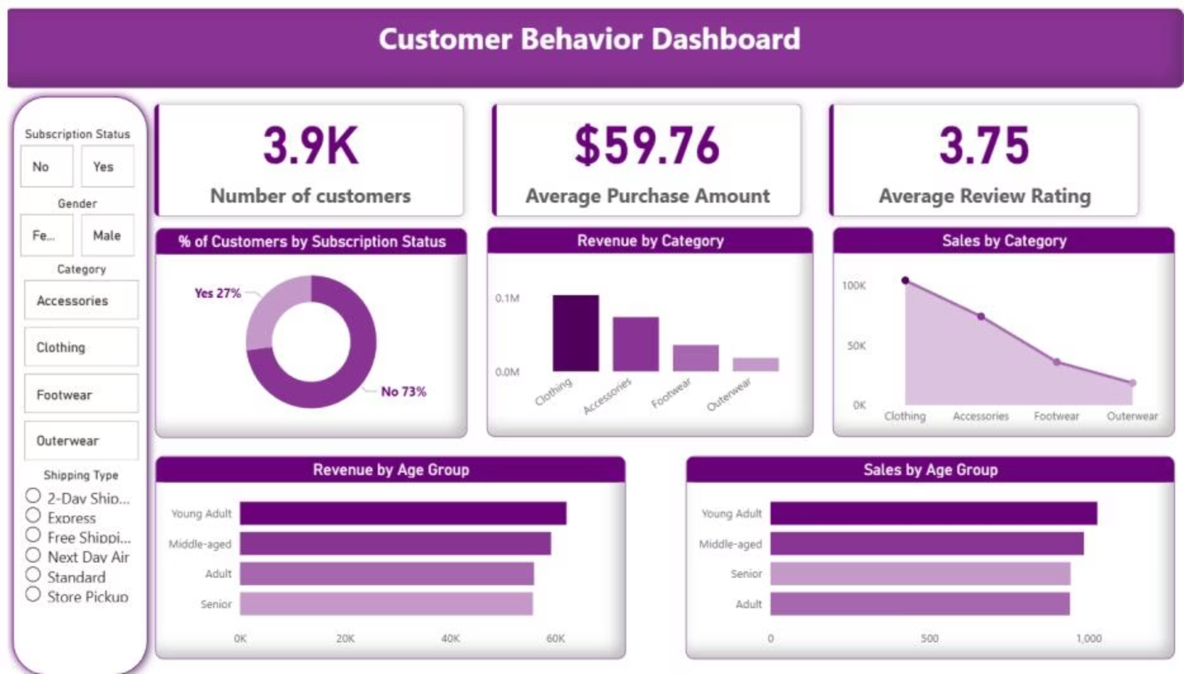
Interactive Dashboard Insights
Visualizing customer behavior in Power BI for dynamic analysis.
3.9K
$59.76
3.75
Customers
Avg. Purchase
Avg. Review Rating

Slide 10

Business Recommendations
Boost Subscriptions
Promote exclusive benefits to increase subscriber base.
Customer Loyalty Programs
Reward repeat buyers to foster loyalty and retention.
Review Discount Policy
Balance sales boosts with margin control for profitability.
Targeted Marketing
Focus campaigns on high-revenue age groups and express-shipping users.

